Slide 1
Introduction to InfoSec Certifications
Certification Prep Day 1

Slide 2

Class Objectives
By the end of class, you will be able to:
Explain the value of certifications in your job search and career development.
Map out certification roadmaps based on your specific experience level and field of interest.
Use CompTIA’s CertMaster tool to begin preparing for the Security+ exam.
Notes:
Shutterstock_1606325344

Slide 3
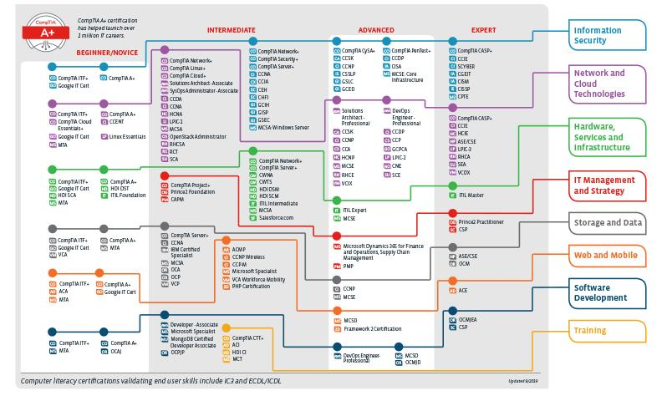
Certifications by the Numbers
As of April 2020, there are 44 organizations that issue over 300 cybersecurity certifications, for 25 specializations and paths.
(certification.comptia.org)

Slide 4

While the amount of certifications, issuing organizations, and certification paths may seem overwhelming, this week we will navigate:
How certifications are beneficial to an infosec professional.
The difference between beginner, advanced, and specialized certifications.
The order in which certifications should be achieved.
Notes:
shutterstock_1115261003.png

Slide 5


This Week
We will also dive deeper into Security+.
This course comes with a voucher for the Security + exam. Therefore, we will spend the most time with this certification.
We will cover:
Test preparation tips
The CompTIA CertMaster study tool
Performance-based questions (PBQ)
Domains on the exam that are not covered in this course's curriculum.
(comptia.org)

Slide 6
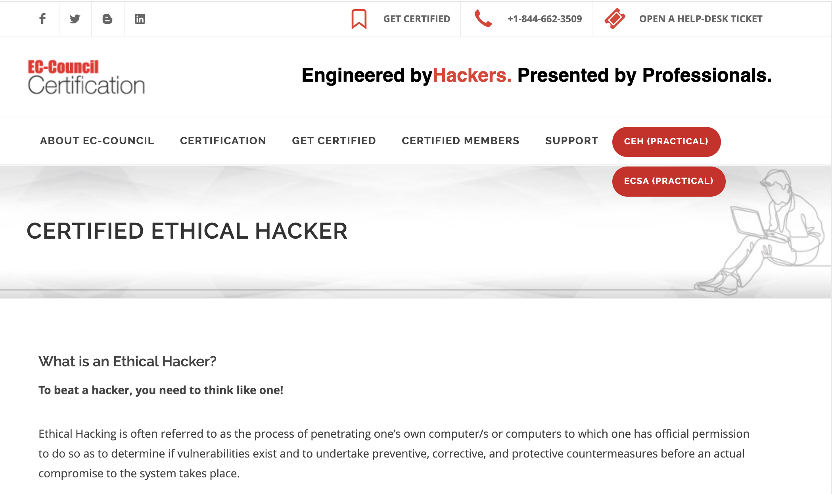
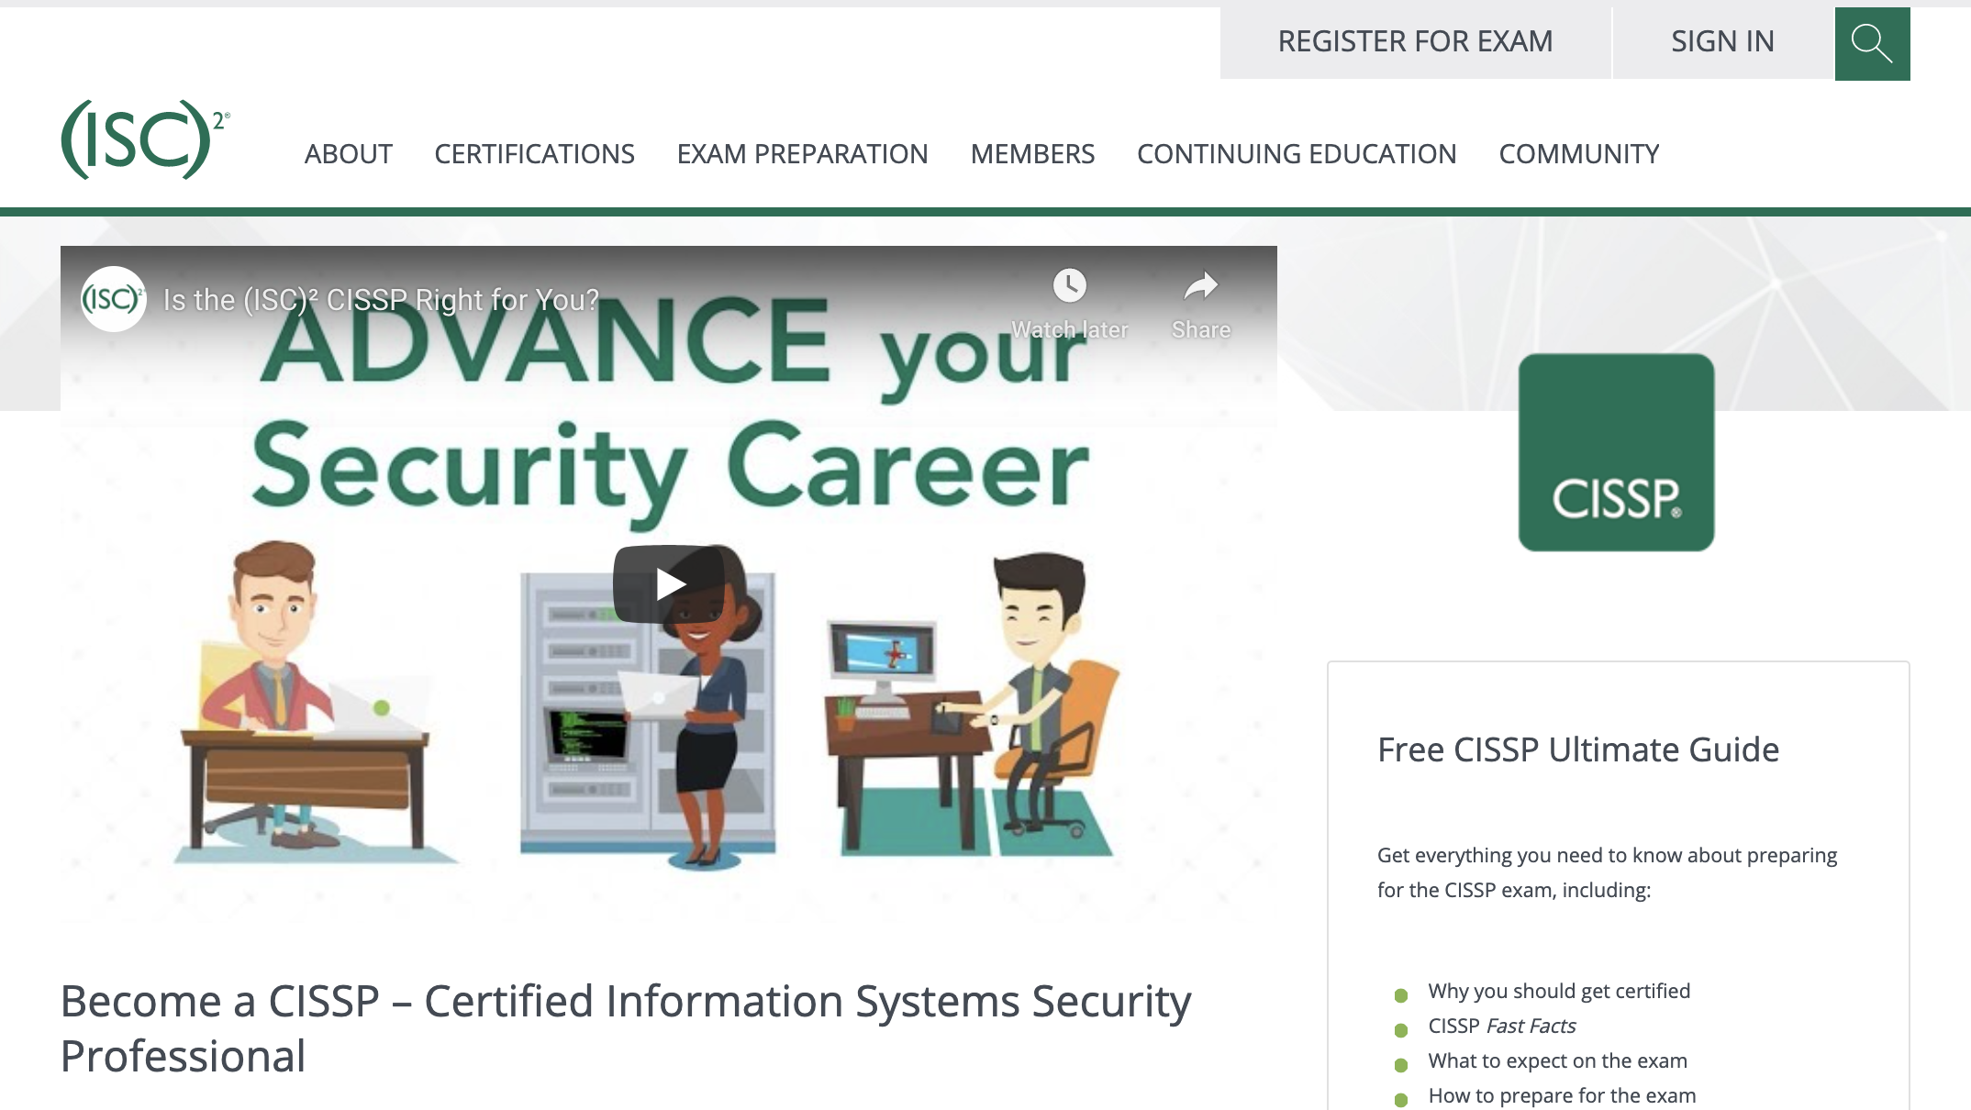
This Week
We will also briefly cover another beginner certification called Certified Ethical Hacker (CEH) and a popular advanced certification, Certified Information Systems Security Professional (CISSP).
(cert.eccouncil.org)
(isc2.org)

Slide 7
Benefits of
InfoSec Certifications

Slide 8

Information Security Certifications
Certifications will give many new candidates an advantage when applying to their first cyber security jobs.
Certifications also provide the following benefits to all levels of infosec professionals:
01
Education
02
Networking
03
Career Advancement
Notes:
shutterstock_523023427

Slide 9

Information Security Certifications
01
Education
Individuals will learn new skills while preparing for a certification, even before the certification is formally awarded. While achieving credentials is often the objective, the material learned during studying for the exam is also very valuable to job performance.
Notes:
shutterstock_404189200

Slide 10

Information Security Certifications
02
Networking
Many certifications have national and local organizations that host meetings, conferences, seminars and social events. These events can provide opportunities to network with peers in your field.
Notes:
shutterstock_708582385

Slide 11

Information Security Certifications
03
Career Advancement
Information security certifications can also place more established professionals in a stronger position to obtain a promotion.
Notes:
shutterstock_1444078949

Slide 12
Levels of InfoSec Certifications

Slide 13
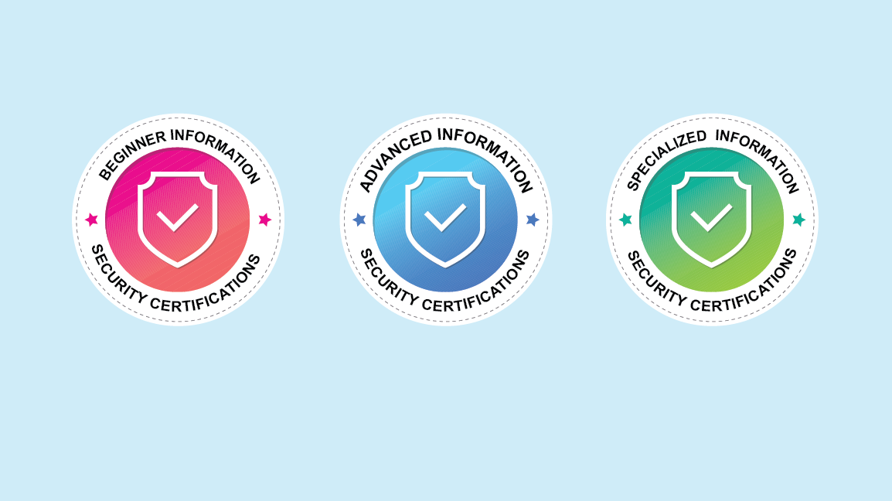
Types of InfoSec Certifications
Certifications can be broken into three categories:
Beginner information security certifications
The first certifications that individuals new to the field should obtain.
Advanced information security certifications
Should be obtained after working in the industry for several years.
Specialized information security certifications
Focus on a specific domain and should be obtained after working in the industry for several years.
Notes:
shutterstock_1488208328

Slide 14
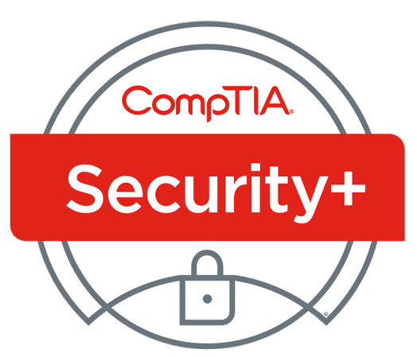
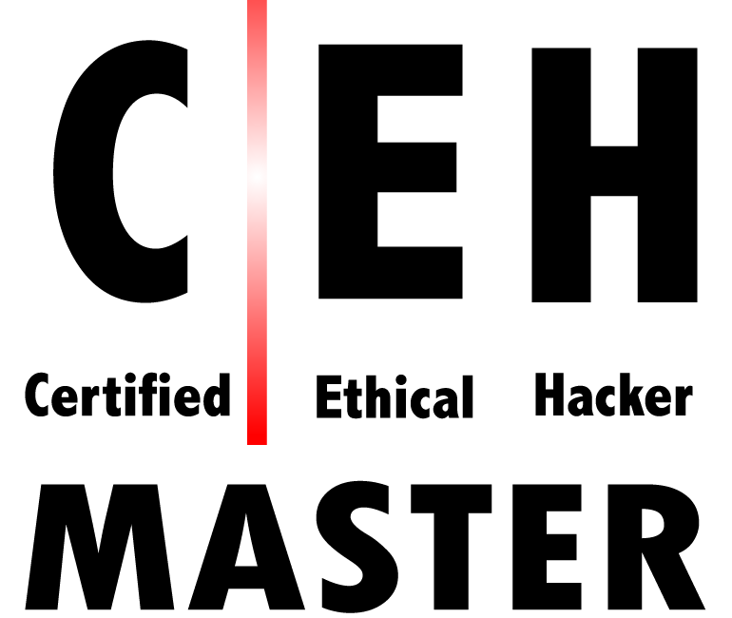

Beginner Certifications
Examples include: Security+, CEH, and GSEC
Typically do not have minimum work requirements or prerequisite courses.
Typically broad in the subjects that they cover.
‹#›

Slide 15

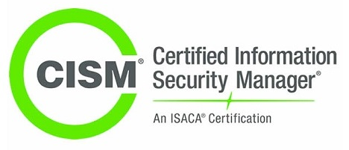
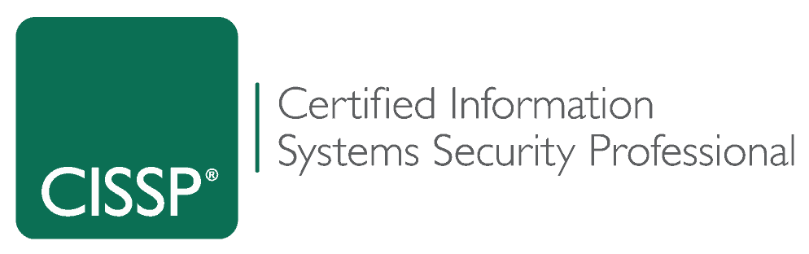
Advanced Certifications
Examples include: CISM and CISSP
Often focus on security management.
Typically have minimum work requirements and prerequisite courses.
‹#›

Slide 16
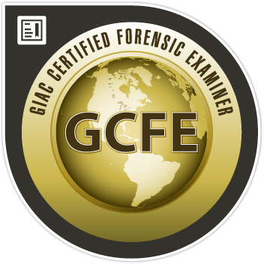

Specialized Certifications
Typically have minimum work requirements and prerequisite courses.
Specific in the subjects that they cover.
GIAC Certified Forensic Examiner (GCFE) is specific to forensics professionals.
Offensive Security Certified Professional (OSCP) and PenTest+ are specific to penetration testers.
‹#›

Slide 17

Specialized Certifications
Non-vendor specific
Specialized certifications can be vendor or non-vendor specific.
OSCP is a non-vendor specific penetration testing certification.
Vendor specific
Cisco Certified Network Associate (CCNA) is a vendor-specific certification for Cisco products.
‹#›

Slide 18
Certification Career Pathways

Slide 19

Certification Pathways
Penetration testers may follow this path:
01
02
03
04
Security+
CEH
CISSP
OSCP
Notes:
shutterstock_1536230735

Slide 20
Certification Pathways
Forensic investigators may follow this path:
01
02
03
04
Security+
CFCE
GCFA
EnCE
Notes:
shutterstock_1536230735

Slide 21
Activity: Certifications and Careers
In this activity, you will use job search websites to research infosec careers and certifications.
7 Minutes

Slide 23
Beginner Certifications

Slide 24

While Security+ will likely be the first certification you’ll work towards, there are several other beginner infosec certifications that don’t require experience and cover many domain areas.
‹#›

Slide 25
Certified Ethical Hacker (CEH) is a certification offered by EC Council.
While the CEH is generally focused on penetration testing, it also covers a broad range of topics relevant to infosec professionals.
CEH also offers an advanced certification, CEH Practical, which tests individuals skills with hands-on penetration testing tools.

Slide 26
GIAC Security Essentials (GSEC) is a certification offered by the Global Information Assurance Certification (GIAC).
GSEC covers a broad range of topics ranging from active defense to cryptography.

Slide 27

Systems Security Certified Professional (SSCP) is a certification offered by (ISC)² (“ISC squared”).
SSCP covers security best practices for setting up, monitoring, and administering IT infrastructure.
While SSCP is one of the entry-level certifications offered by (ISC)², they do request one year of professional cybersecurity experience.

Slide 28
Advanced Certifications

Slide 29

Many cyber professionals advance their careers by obtaining advanced and specialized certifications.
Notes:
shutterstock_1023890479

Slide 30
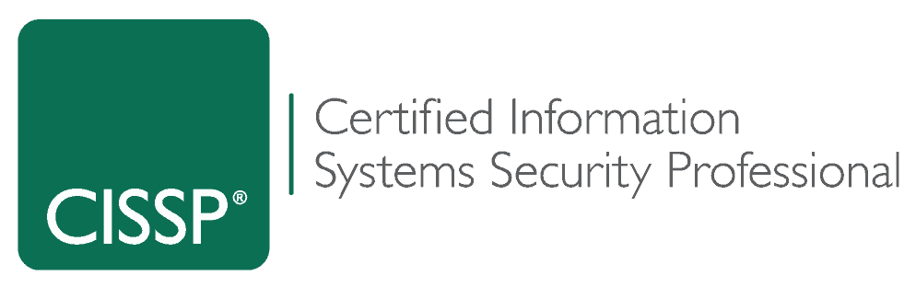
Certified Information Systems Security Professional (CISSP) is an advanced certification offered by ISC2.
It covers a wide variety of cybersecurity topics and is one of the most popular certifications in information security.

Slide 31
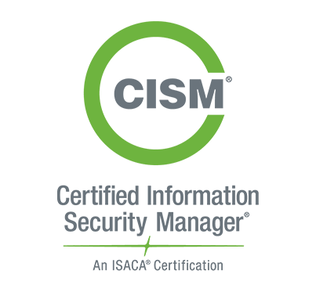
Certified Information Security Manager (CISM) is a certification offered by ISACA.
It covers information security management topics.

Slide 32
Specialized Certifications

Slide 33
There are hundreds of specialized certifications available for those interested in mastering a specific cybersecurity domain.
‹#›

Slide 34

Offensive Security Certified Pentester (OSCP) is a specialized pen testing certification offered by Offensive Security.
It is a practical exam consisting of two parts: a 24-hour penetration testing exam and a documentation report due 24 hours after the exam.

Slide 35
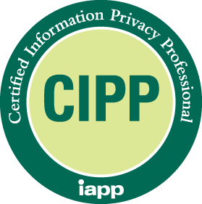
Certified Information Privacy Professional (CIPP) is a specialized privacy certification offered by IAPP.
It is considered the “gold standard” for those working in privacy.

Slide 36

EnCase Certified Examiner (EnCE) is a vendor-specific specialized certification for computer forensics professionals.
It is offered by OpenText and used by law enforcement.

Slide 37
Activity: Advanced and Specialized Certifications
In this activity, you will research several advanced and specialized certifications.
0:07

Slide 39
‹#›
Notes:
Image source: AdobeStock_56885471

Slide 40
Introduction to Security+

Slide 41

What is a Security+?
According to CompTIA:
Security+ is the first security certification IT professionals should earn.
It establishes the core knowledge required of any cybersecurity role and provides a springboard to intermediate-level cybersecurity jobs.
Security+ incorporates best practices in hands-on trouble-shooting to ensure security professionals have practical security problem-solving skills.
Cybersecurity professionals with Security+ know how to address security incidents – not just identify them.
Notes:
shutterstock_1435284368

Slide 42
Introduction to Security+ Certification
What are some jobs that may require the Security+ certification?
Security
Consultant
Security
Architect
Information Security
Analyst
Security
Engineer
Security
Specialist
Security /
Systems
Administrator

Slide 43
As of June 2020, the average annual pay for an information security analyst in the United States is $99,944 a year.
Source: ZipRecruiter
‹#›

Slide 44
Introduction to Security+ Certification
What are some topics covered by Security+?
Threats, Attacks, and Vulnerabilities
Identity and Access Management
Technologies and Tools
Risk Management
Architecture and Design
Cryptography and PKI

Slide 45

Security+ Specs
The Security+ Certification is obtained by passing the CompTIA-administered Security+ exam.
There are 90 multiple-choice and performance based questions.
The exam lasts 90 minutes.
The cost of the exam is $339.
The exam is vendor-neutral.
(You will receive a voucher)
‹#›
Notes:
Image source: shutterstock_1276756537

Slide 46

Preparation Tips
While there are many books, online resources, study guides, and apps available to help prepare for the exam, CompTIA provides the most up-to-date resources for exam prep.
Focus on your weak spots.
Organize your study time.
Use supplemental study tools.
Use CompTIA’s study tools.
Find a Security+ online community.
Notes:
shutterstock_662660182

Slide 47

Preparation Tips
Design a structured study plan and stick with it. Block out at least several weeks to focus on studying for the exam.
Focus on your weak spots.
Organize your study time.
Use supplemental study tools.
Use CompTIA’s study tools.
Find a Security+ online community.
Notes:
shutterstock_662660182

Slide 48

Preparation Tips
Early on, attempt to determine which domains are the most challenging, and focus your studies there.
Focus on your weak spots.
Organize your study time.
Use supplemental study tools.
Use CompTIA’s study tools.
Find a Security+ online community.
Notes:
shutterstock_662660182

Slide 49

Preparation Tips
Create study guides and flashcards of common terms and acronyms. Find video content explaining confusing subjects.
Focus on your weak spots.
Organize your study time.
Use supplemental study tools.
Use CompTIA’s study tools.
Find a Security+ online community.
Notes:
shutterstock_662660182

Slide 50

Preparation Tips
There are many online blogs, forums (e.g., Reddit), and wiki pages dedicated to preparing for the Security+ exam.
Focus on your weak spots.
Organize your study time.
Use supplemental study tools.
Use CompTIA’s study tools.
Find a Security+ online community.
Notes:
shutterstock_662660182

Slide 51

Test Taking Tips
01
Take care of yourself. Arrive early, well-rested, fed, hydrated, and relaxed.
02
Pay attention. Read each question and each answer twice before deciding on your answer. Always stay aware of how much time remains.
03
If you’re unsure of an answer, guess. Eliminate the answers you know are wrong, and select from the remaining answers. You'll receive the same penalty for an incorrect answer as for an unanswered question, so always make a best guess.
(Source)
Notes:
Image source: Jeevanantham_Jiva

Slide 52
Security+ CertMaster

Slide 53
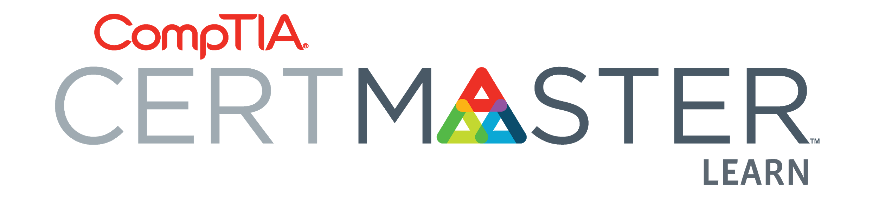
CertMaster Practice Tool
As part of this boot camp, you will be provided with access to the CertMaster Practice tool.
Per CompTIA, CertMaster Practice provides:
Quick knowledge assessment.
Adaptive learning that reinforces existing and new knowledge.
Personalized feedback.
Real-time learning analytics.

Slide 54
Now we will complete a walkthrough of the CertMaster tool and how to navigate the basic features.
‹#›

Slide 55
CertMaster

Slide 56
Activity: Security+ CertMaster
In this activity, you will access your Security+ CertMaster study tool and complete one module of 12 questions.
7 Minutes

Slide 58

Performance Based Questions (PBQs)
The Security+ exam has two types of questions: multiple choice and performance-based questions (PBQs).
PBQs present test takers with a simulated environment, such as a network, firewall, or terminal.
Since the question environment is simulated and not live, there may be limitations compared to a real- world environment.
PBQs are often the first questions given on the Security+ exam.
Notes:
shutterstock_1276756537

Slide 59

Example Question: Performance-Based
Scenario: You are responsible for security at a small organization and have been tasked with implementing a security policy. Place the actions of organizing a security policy in their appropriate order. Note that there are five options, but you need to choose four.
Step 1 ______ > Step 2 ______ > Step 3 ______ > Step 4 ______
Possible choices:
Obtain support and commitment from management
Analyze risks to security
Secure budgeting
Review, test, and update procedures
Implement appropriate controls
Notes:
Image source: shutterstock_1169662366

Slide 60
Example Question: Performance-Based
Scenario: You are responsible for security at a small organization and have been tasked with implementing a security policy. Place the actions of organizing a security policy in their appropriate order. Note that there are five options, but you need to choose four.
Step 1 ______ > Step 2 ______ > Step 3 ______ > Step 4 ______
Step 1: Obtain support and commitment from management
Step 2: Analyze risks to security
Step 3: Implement appropriate controls
Step 4: Review, test, and update procedures
Notes:
Image source: shutterstock_1169662366

Slide 61
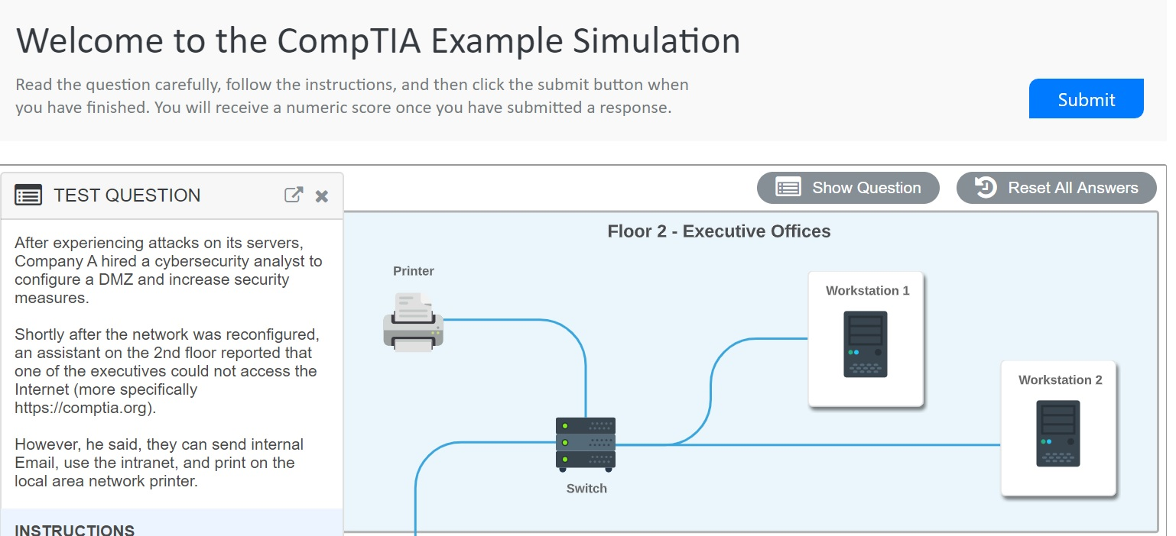
PBQs
In the next guided tour, we will explore Security+ PBQ questions.

Slide 62
PBQs

Slide 63
Activity: Security+ PBQs
In this activity, you will work through several Security+ PBQ questions.
7 Minutes

Slide 65

Next class, we’ll dive deeper into the various domains and topics of the Security+ exam.
Notes:
Image source: shutterstock_1149661154

